Slide 1
Software Foundations of Security and Privacy (15-316, spring 2017) Lecture 7: Proof-Carrying Code
Jean Yang
jyang2@andrew.cmu.edu
With material from Peter Lee and David Walker (who borrowed material from Greg Morrisett)

Slide 2
Perfectly Avoidable Dangers
“‘I was coming back from lunch and I spotted this USB drive on the bench over here,’ Harty said. ‘I watched for a little while and then I looked around to see if there was anybody here that was going to pick it up. I figured I needed a USB drive, so I picked it up.’” –NBC Chicago

Slide 3

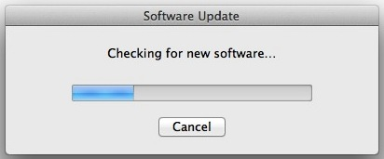

Less Avoidable Dangers

Slide 4



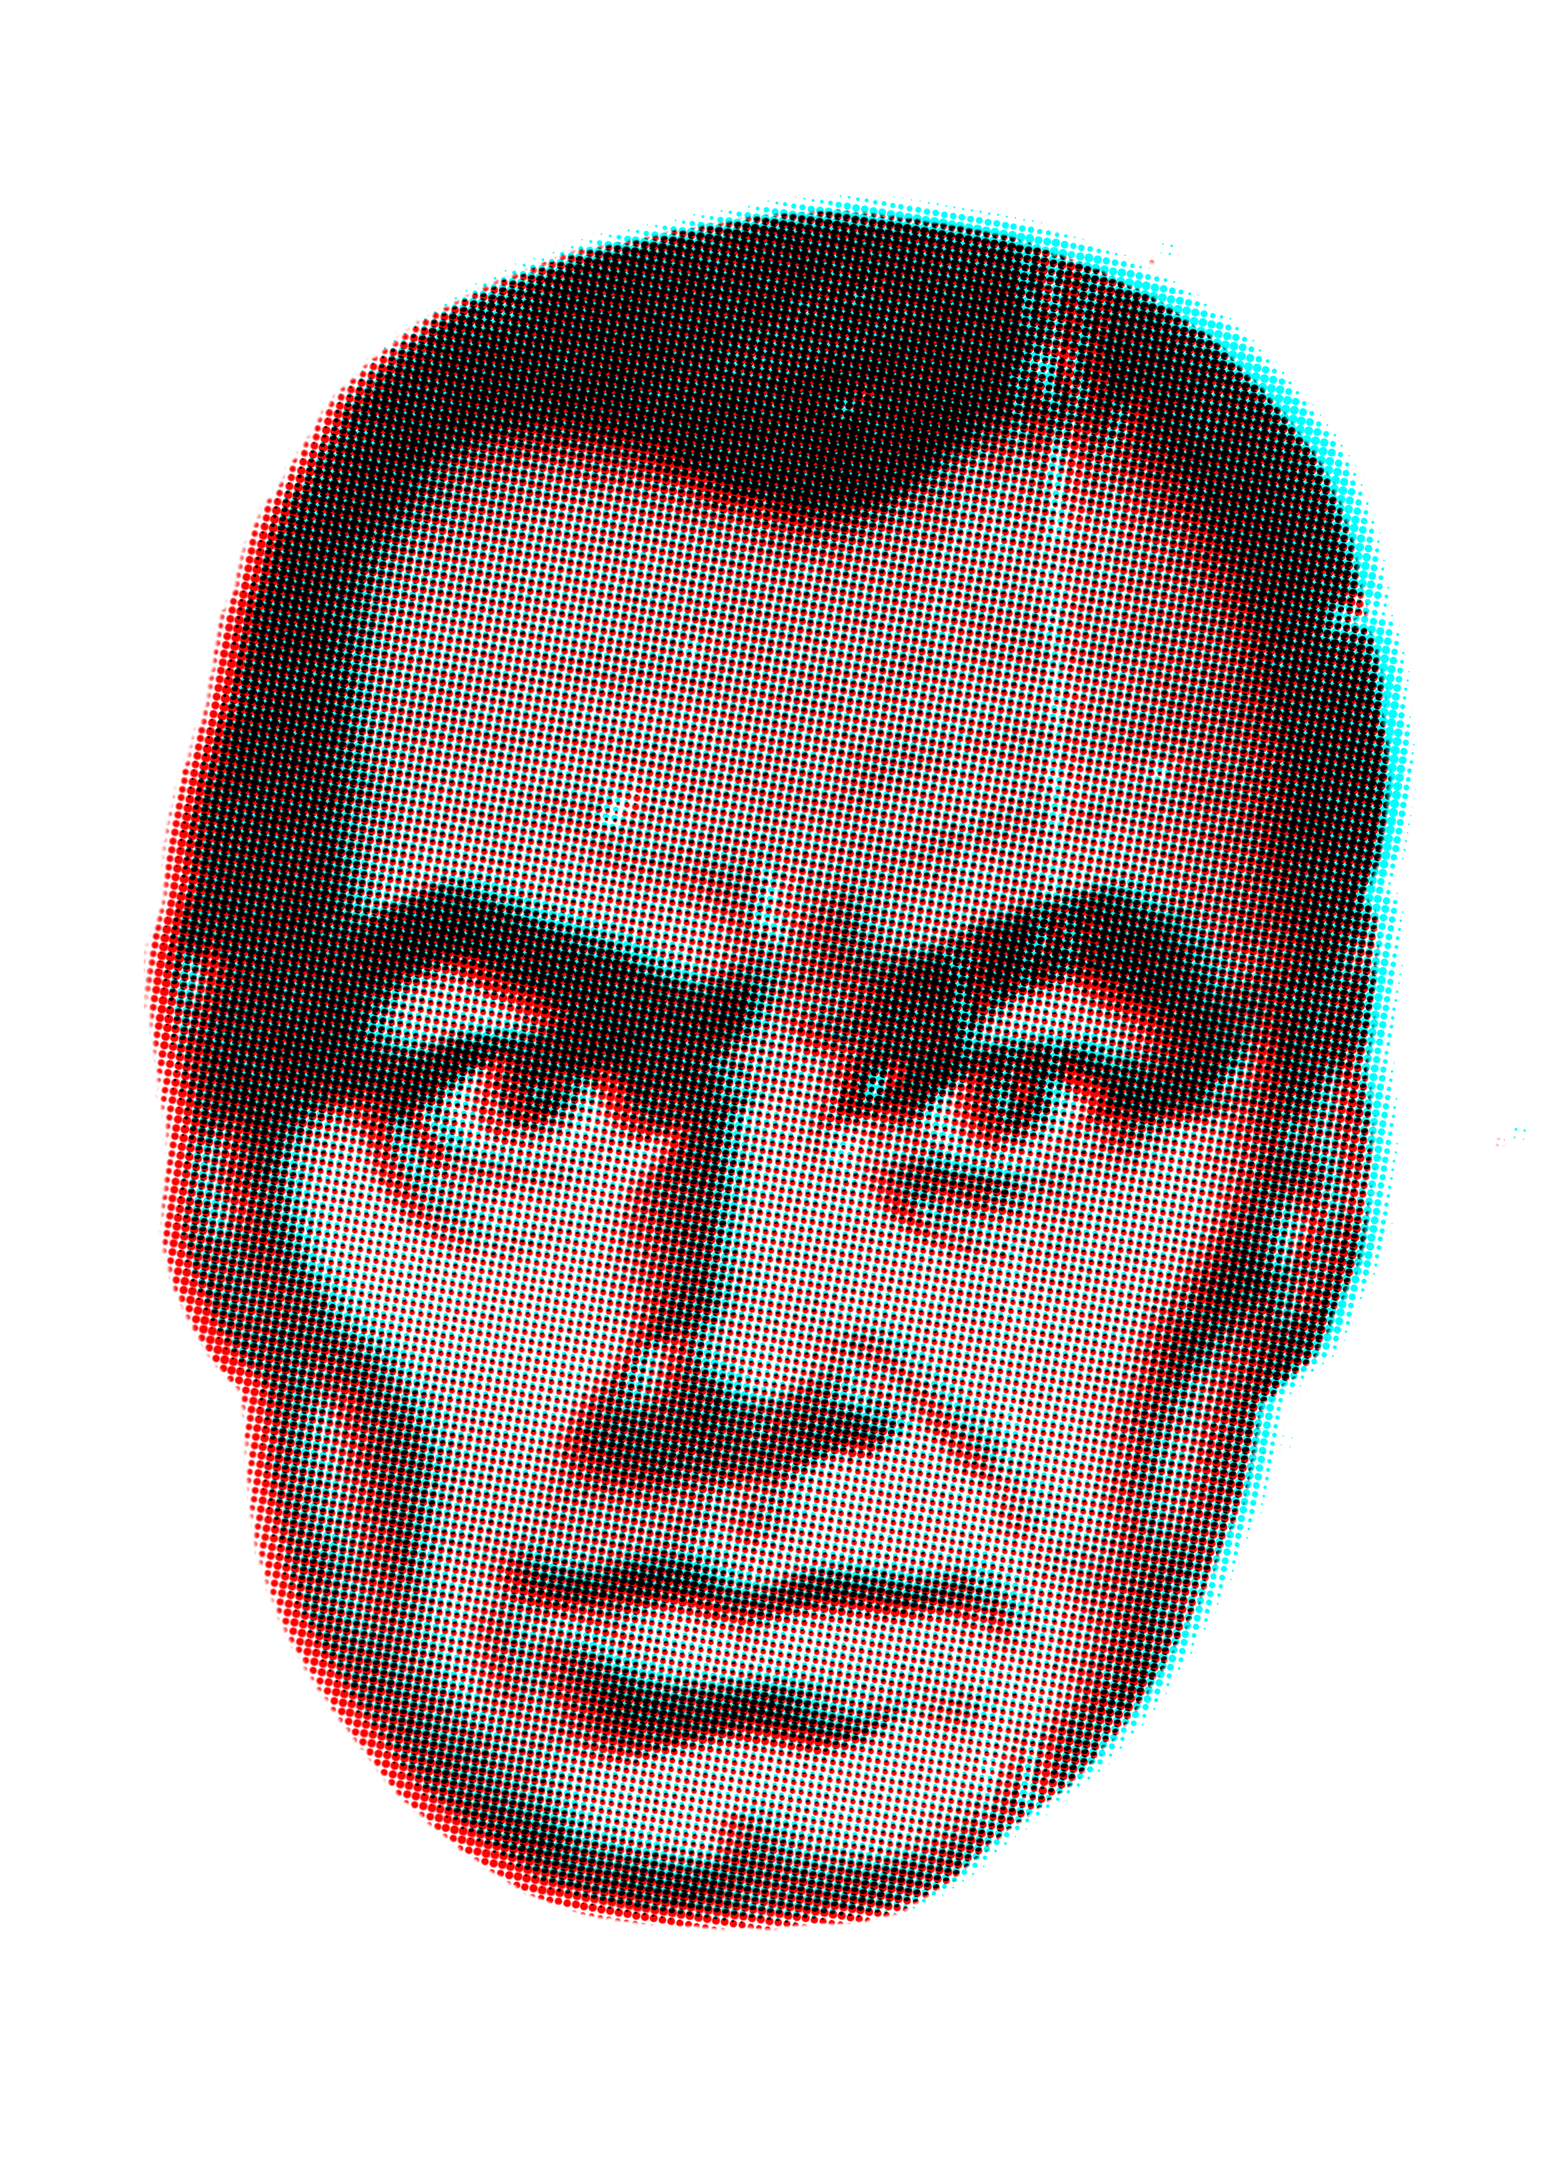
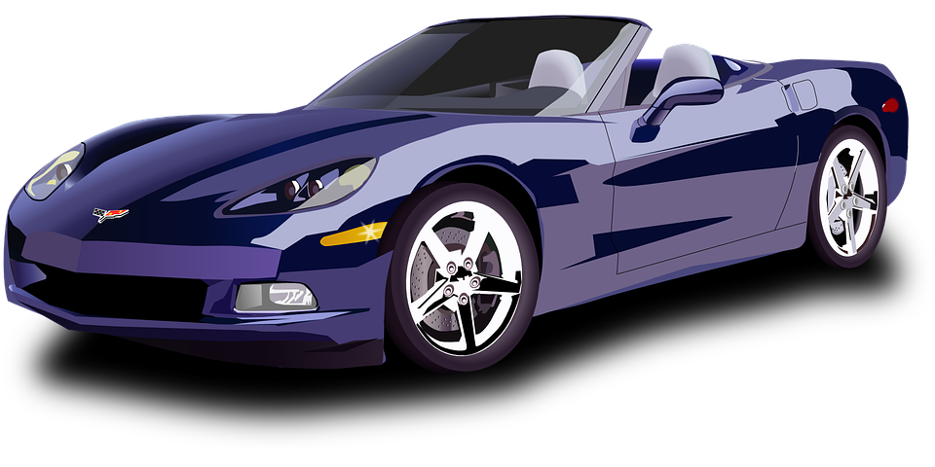
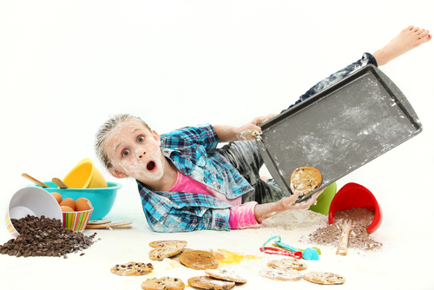
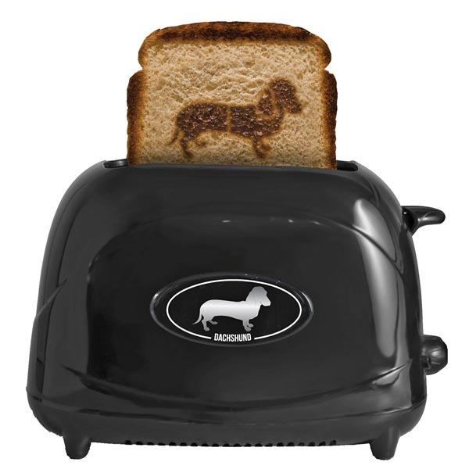
Code Safety, the #1 Existential Threat

Slide 5
Approach 1 Trust the code producer
Slide from Peter Lee
Code
sig
Trust is based on personal authority, not program properties
PK1
Scaling problems?
PK2
CPU
PK1
PK2
Trusted Host
Trusted 3rd Party

Slide 6
Approach 2 Baby-sit the program
Slide from Peter Lee
Code
Expensive
Execution monitor
CPU
E.g., Software Fault Isolation [Wahbe & Lucco], Inline Reference Monitors [Schneider]
Trusted Host

Slide 7
Approach 3 Java
Slide from Peter Lee
Code
Verifier
Limited in expressive power
Interp/ JIT
Expensive and/or big
CPU
Trusted Host

Slide 8
Approach 4 Formal verification
Slide from Peter Lee
Code
Theorem
Prover
Flexible and
powerful.
CPU
But really really
really hard and
must be correct.
Trusted Host

Slide 9
A key idea: Checkable certificates
Slide from Peter Lee
Code
Certifying
Prover
Proof
Checker
Proof
CPU
Trusted Host

Slide 10
A key idea: Checkable certificates
Slide from Peter Lee
Code
Certifying
Prover
Proof
Checker
Proof
CPU

Slide 11
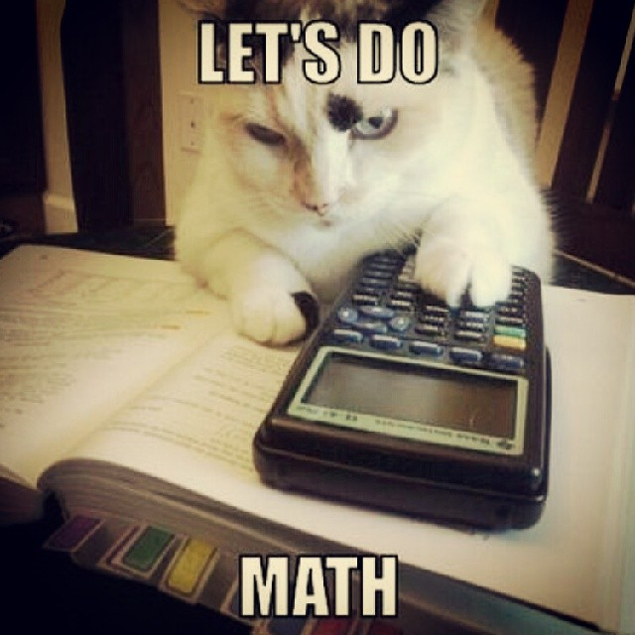
Proof-Carrying Code: Five Frequently Asked Questions
[Necula and Lee, OSDI ‘96]

Slide 12
Question 1
Slide from Peter Lee
How are the proofs represented and checked?

Slide 13
Formal proofs
Slide from Peter Lee
Write “x is a proof of predicate P” as x:P.
What do proofs look like?

Slide 14
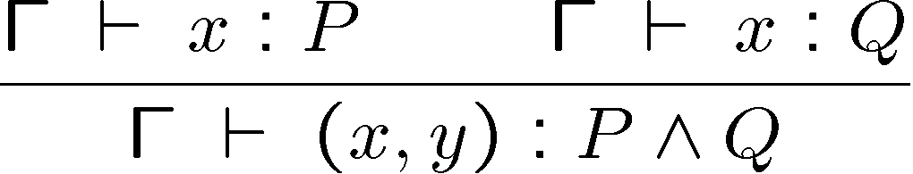
Example inference rule
Slide from Peter Lee
If we have a proof x of P and a proof y of Q, then x and y together constitute a proof of P ∧ Q.
Or, in ASCII:
Given x:P, y:Q then (x,y):P*Q.

Slide 15
More inference rules
Slide from Peter Lee
Assume we have a proof x of P. If we can then obtain a proof b of Q, then we have a proof of P ⇒ Q.
Given [x:P] b:Q then fn (x:P) => b : P → Q.
More rules:
Given x:P*Q then fst(x):P
Given y:P*Q then snd(y):Q

Slide 16
Types and proofs
Slide from Peter Lee
So, for example:
fn (x:P*Q) => (snd(x), fst(x)) : P*Q → Q*P
This is an ML program!
Also, typechecking provides a “smart” blackboard!

Slide 17
Curry-Howard Isomorphism
Slide from Peter Lee
In a logical framework language, predicates can be represented as types and proofs as programs (i.e., expression terms).
Furthermore, under certain conditions typechecking is sufficient to ensure the validity of the proofs.
Notes:
“Proofs as Programs”
“Propositions as Types”
The Edinburgh Logical Framework language, or LF, provides an expressive language for proofs-as-programs.
Furthermore, its use of dependent types allows, among other things, the axioms and rules of inference to be specified as well

Slide 18
Question 2
Slide from Peter Lee
How well does this work in practice?

Slide 19
The Necula-Lee experiments
Slide from Peter Lee
Reasonable in size (0-10%).
Code
Certifying
Prover
Proof
Checker
Proof
CPU
Simple,
small (<52KB),
and fast.
No longer need to
trust this component.

Slide 20
Crypto test suite results
Slide from Peter Lee
sec

Slide 21
Question 3
Slide from Peter Lee
Aren’t the properties we’re trying to prove undecideable?
How on earth can we hope to generate the proofs?

Slide 22
Solution: Programming Languages!
Slide from Peter Lee
Civilized programming languages can provide “safety for free”
Well-formed/well-typed ⇒ safe
Idea: Arrange for the compiler to “explain” why the target code it generates preserves the safety properties of the source program

Slide 23
Certifying Compilers [Necula & Lee, PLDI’98]
Slide from Peter Lee
Intuition:
Compiler “knows” why each translation step is semantics-preserving
So, have it generate a proof that safety is preserved

Slide 24
Certifying compilation
Slide from Peter Lee
Certifying
Prover
Certifying
Compiler
Object
code
Source
code
Proof
Proof
Checker
CPU
Looks and smells like a compiler.
% spjc foo.java bar.class baz.c -ljdk1.2.2

Slide 25
Question 4
Slide from Peter Lee
Just what, exactly, are we proving?
What are the limits?
And isn’t static checking inherently less powerful than dynamic checking?

Slide 26
Semantics
Slide from Peter Lee
Define the states of the target machine
S = (Π, ρ, pc)
and a transition function Step(S).
Define also the safe machine states via the safety policy SP(S).
program
program counter
register state

Slide 27
Semantics, cont’d
Slide from Peter Lee
Then we have the following predicate for safe execution:
Safe(S) = Πn:Nat. SP(Step^{n}(S))
and proof-carrying code:
PCC = (S₀:State, P:Safe(S₀))

Slide 28
Reference Interpreters
Slide from Peter Lee
A reference interpreter (RI) is a standard interpreter extended with instrumentation to check the safety of each instruction before it is executed, and abort execution if anything unsafe is about to happen.
In other words, an RI is capable only of safe execution.

Slide 29
Reference Interpreters cont’d
Slide from Peter Lee
The reference interpreter is never actually implemented.
The point will be to prove that execution of the code on the RI never aborts, and thus execution on the real hardware will be identical to execution on the RI.

Slide 30
Questions
Slide from Peter Lee
Suppose that we require the code to execute no more than N instructions. Is such a safety property enforceable by an RI?
Suppose we require the code to terminate eventually. Is such a safety property enforceable by an RI?

Slide 31
What can’t be enforced?
Slide from Peter Lee
Safety properties ⇒ Yes
“No bad thing will happen”
Liveness properties ⇒ Not yet
“A good thing will eventually happen”

Slide 32
Static vs dynamic checking
Slide from Peter Lee
PCC provides a basis for static enforcement of safety conditions
However, PCC is not just for static checking
PCC can be used, for example, to verify that necessary dynamic checks are carried out properly

Slide 33
Question 5
Slide from Peter Lee
Even if the proof is valid, how do we know that it is a safety proof of the given program?

Slide 34
Slide from Peter Lee
OK, but let me quickly look over the instructions first.
Please install and execute this.
Code producer
Host

Slide 35
Slide from Peter Lee
Code producer
Host

Slide 36
Slide from Peter Lee
This store instruction is dangerous!
Code producer
Host

Slide 37
Slide from Peter Lee
Can you prove that it is always safe?
Code producer
Host

Slide 38
Slide from Peter Lee
Yes! Here’s the proof I got from my certifying Java compiler!
Can you prove that it is always safe?
λ
Code producer
Host

Slide 39
Slide from Peter Lee
Your proof checks out. I believe you because I believe in logic.
λ
Code producer
Host

Slide 40
The safety policy
Slide from Peter Lee
We need a method for
identifying the dangerous instructions, and
generating logical predicates whose validity implies that the instruction is safe to execute
In practice, we will also need
specifications (pre/post-conditions) for each required entry point in the code, as well as the trusted API.

Slide 41
High-level architecture
Slide from Peter Lee
Code
Code
analyzer
Checker
Explanation
Agent
Safety
policy
Host

Slide 42
High-level architecture
Slide from Peter Lee
Code
Verification
condition
generator
Proof
checker
Proof
Agent
Proof
rules
Host

Slide 43
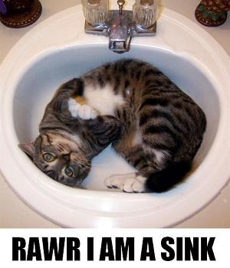
Case Study: Program Resource Usage

Slide 44
A case study
Slide from Peter Lee
As a case study, let us consider the problem of verifying that programs do not use more than a specified amount of some resource.
s ::= skip
| i := e
| if e then s else s
| while e do s
| s ; s
| use e
e ::= n
| i | read()
| e + e | e – e | …
Denotes the use of n pieces of the resource, where e evaluates to n

Slide 45
Case study, cont’d
Slide from Peter Lee
Under normal circumstances, one would implement the statement:
use e;
in such a way that every time it is executed, a run-time check is performed in order to determine whether n pieces of the resource are available (assuming e evaluates to n).

Slide 46
Case study, cont’d
Slide from Peter Lee
However, this stinks because many times we should be able to infer that there are definitely available resources.
If somehow we know that there are ≥9 available here…
…
if …
then use 4;
else use 5;
use 4;
…
…then certainly there is no need to check any of these uses!

Slide 47
An easy (well, probably) case
Slide from Peter Lee
Program Static
i := 0
while i < 10000
use 1
i := i + 1
We ought to be able to prove statically whether the uses are safe

Slide 48
A hopeless case
Slide from Peter Lee
Program Dynamic
while read() != 0
use 1

Slide 49
An interesting case
Slide from Peter Lee
Program Interesting
N := read()
i := 0
while i < N
use 1
i := i + 1
In principle, with just a single dynamic check, static proof ought to be possible

Slide 50
Also interesting
Slide from Peter Lee
Program AlsoInteresting
while read() != 0
i := 0
while i < 100
use 1
i := i + 1

Slide 51
A core principle of PCC
Slide from Peter Lee
In the code, the implementation of a safety-critical operation should be separated from the implementation of its safety checks.

Slide 52
Separating use from check
Slide from Peter Lee
So, what we would like to do is to separate the safety check from the use.
We do this by introducing a new construct, acquire
acquire requests n amount of resource; use no longer does any checking
s ::= skip
| i := e
| if e then s else s
| while e do s
| s ; s
| use e
| acquire e

Slide 53
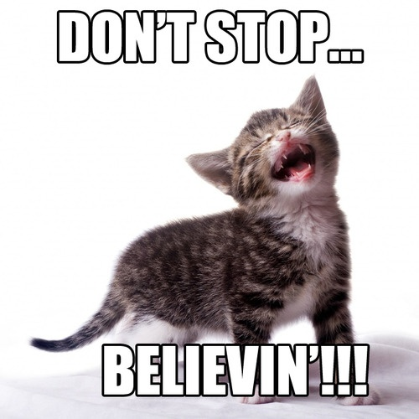
PCC to the Limit: Typed Assembly

Slide 54
Typed Assembly
Assembly code is annotated with type information that can be verified by our type checker.
Type soundness implies many important security properties such as memory safety.
TAL applets, like Java applets, may be downloaded from untrusted sources on the internet, verified, and executed safely without fear they will corrupt the host machine.
Because TAL is assembly language, there is no interpretation overhead during this process and no just-in-time compiler to run or trust.

Slide 55
Typed Assembly
Slide from David Walker
A type system for assembly language(s):
built-in abstractions (tuple,code)
operators to build new abstractions (∀,∃,λ)
annotations on assembly code
an abstraction checker
Thm: well-annotated code cannot violate
abstractions.

Slide 56
TAL Work[popl 98, toplas 99 & others]
Slide from David Walker
Theory:
small RISC-style assembly language
compiler from System F to TAL
soundness and preservation theorems
Practice:
most of IA32 (32-bit Intel x86)
more type constructors
everything you can think of and more
safe C compiler
~40,000LOC & compiles itself

Slide 57
Why Type Assembly?
Slide from David Walker
Theory:
simplifies proofs of compiler correctness
deeper understanding of compilation
Practice:
compiler debugging
software-based protection

Slide 58
Simple Built-In Types
Slide from David Walker
Bytes: b1, b2, b4
Tuples: (τ₁^{φ1},…,τ_{n}^{φn}) (φ = 0,1)
Code: {r₁:τ₁,…, r_{n}:τ_{n}}
like a pre-condition
argument type of function
no return type because code doesn’t really return, just jumps somewhere else...
Polymorphic types: ∀α.τ, ∃α.τ

Slide 59
Circling Back: Verve
Type-checked
High-level C# code compiles to typed assembly.
Verve is verified against an interface to TAL for end-to-end safety.
Applications
Drivers
File System
Microkernel
Verified
Interface specification
Nucleus
Hardware specification

Slide 60
Discussion Questions
What kinds of properties can proof-carrying code help ensure?
How does proof-carrying code relate to reference monitors?
What guarantees do we get if we have a piece of proof-carrying code?
What are the restrictions that proof-carrying code places on code?

Slide 61
Out Today: Assignment 2
Main idea: implement a simple reference monitor with read/write/append/delegate permissions.
You will need to specify the security automaton, as well as the mediation points.
There will also be an exercise on bounded availability testing your understanding of safety!

